Slide 1
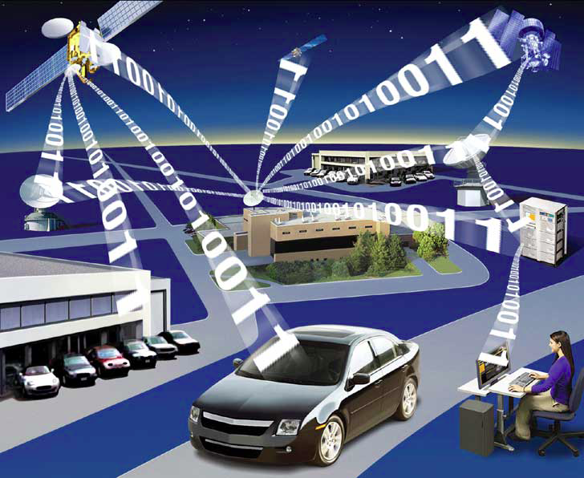
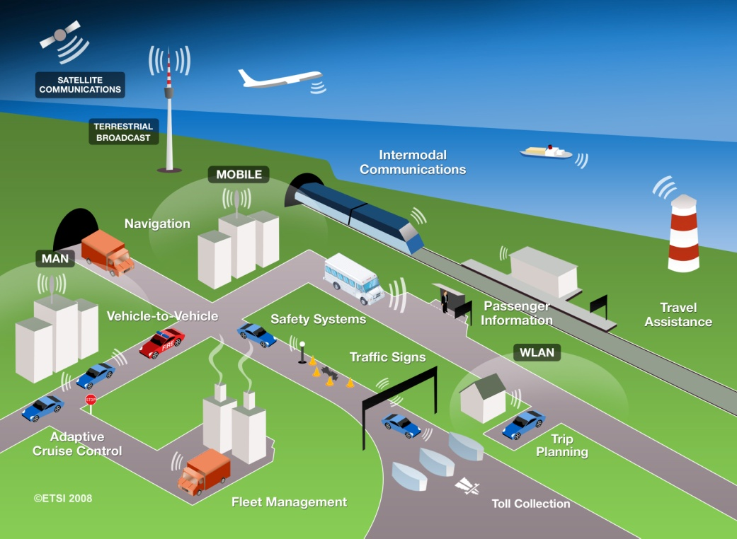
Intelligent Transportation System Using WSNs
Jiannong Cao
Notes:
Wireless sensor networks (WSNs) are emerging as new sensing paradigms to intelligent transportation systems (ITS) due to its low cost, high scalability and ease of deployment. Recent years have witnessed large development in WSN-based ITS. However, practical limitations of WSNs, particularly in terms of power supply, wireless communication and computational capability of wireless nodes, still remain to be roadblocks of realizing practical WSN-based ITS. This presentation is intended to serve as a summary review of the recent advances of using wireless sensors networks forITS. Instead of listing in terms of hardware prototypes and software design, the main challenges of using WSNs for ITS are identified and the corresponding techniques to solve these problems are summarized.

Slide 2
Outline
Intelligent Transportation Systems (ITS)
How WSNs can help ITS?
Existing work of using WSNs for ITS
Challenges and corresponding solutions when using WSNs for ITS
Conclusion

Slide 3
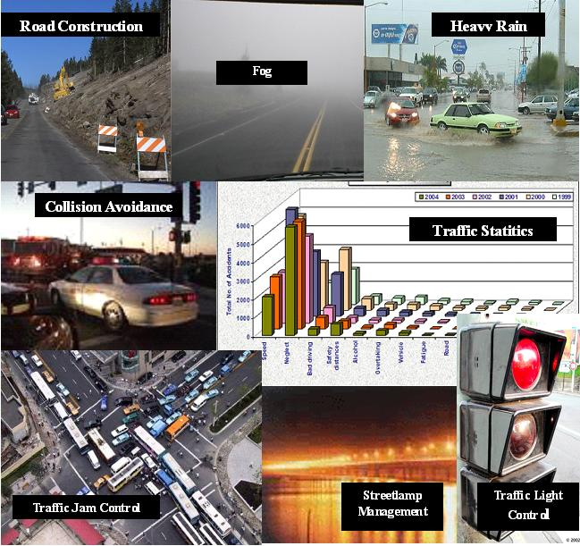
What is ITS?
The application of high technology and computer power to current freeway, traffic, and transit systems to increase the safety and efficiency of the surface transportation system.

Slide 4
ITS Sub-systems
Advanced traveler information system
Advanced transportation management systems
ITS-enabled transportation pricing systems
Advanced public transportation systems
Fully integrated intelligent transportation systems

Slide 5
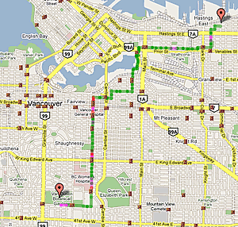
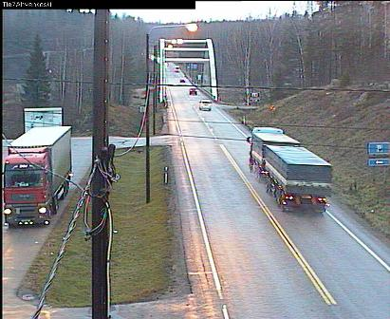
Advanced Traveler Information System
Route information
Weather information
Congestion information

Slide 6
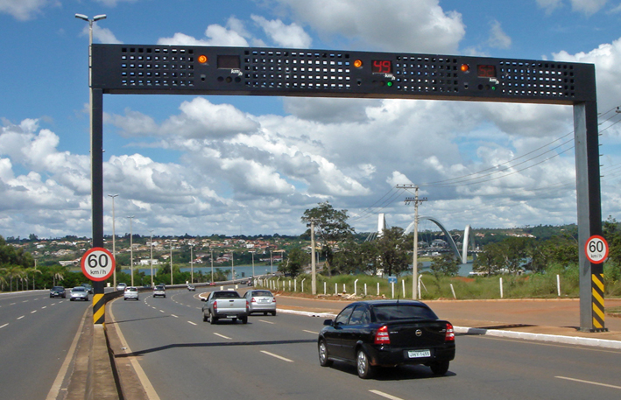
Advanced Transportation Management Systems
Traffic light controlling
Automatic road enforcement

Slide 7
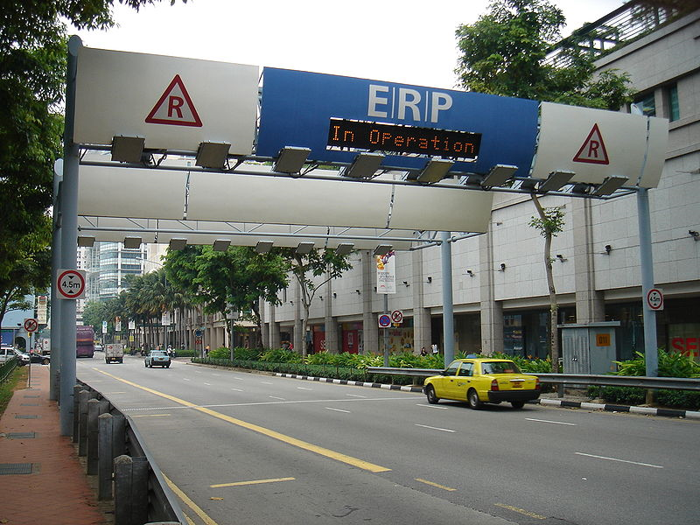
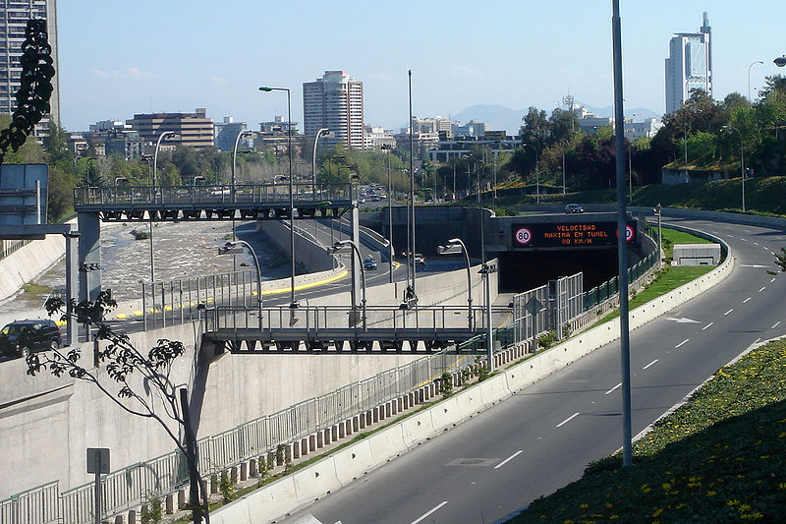
ITS-Enabled Transportation Pricing Systems
Electronic toll
Congestion pricing

Slide 8
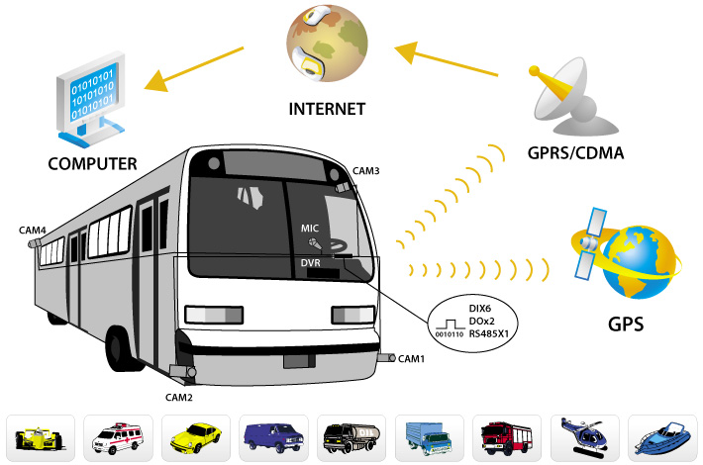
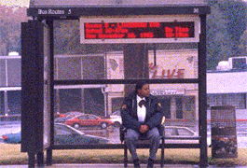
Advanced Public Transportation Systems
Automatic vehicle location systems
Bus/train arrival notification systems

Slide 9
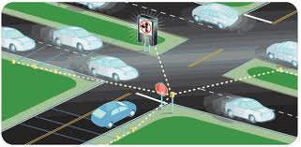
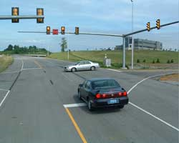
Fully Integrated Intelligent Transportation Systems
Vehicle-to-infrastructure (VII)
Vehicle-to-vehicle (V2V)
Cooperative intersection collision avoidance system

Slide 10
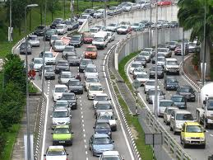
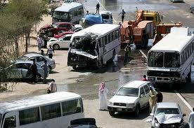
Why ITS?
Increasing safety
Improving operational performance
Enhancing mobility
Delivering environmental benefits
Boosting productivity and expanding economic and employment growth
Notes:
ITS are contributing to a fundamental reassessment of vehicle safety. Whereas most developments in transportation safety over the past 50 years were designed to protect passengers in the event of a crash, VII and V2V systems such as Japan’s Smartway or the United States’ IntelliDrive are being designed to help motorists avoid the accident altogether. For example, the U.S. IntelliDrive system could potentially address 82 percent of vehicle crash scenarios involving unimpaired drivers.
ITS maximize the capacity of infrastructure, reducing the need to build additional highway capacity. For example, applying real-time traffic data to U.S. traffic signal lights can improve traffic flow significantly, reducing stops by as much as 40 percent, reducing travel time by 25 percent, cutting gas consumption by 10 percent (1.1 million gallons of gas annually), and cutting emissions by 22 percent (cutting daily carbon dioxide emissions by 9, 600 tons). ITS can contribute significantly to reducing congestion, which costs U.S. commuters 4.2 billion hours and 2.8 billion gallons of fuel each year, costing the U.S. economy up to $200 billion per year. Overall, ITS can reduce congestion by as much as 20 percent or more. ITS also enable transportation agencies to collect the real-time data needed to measure and improve the performance of the transportation system, making ITS the centerpiece of efforts to reform surface transportation systems and hold providers accountable for results.
By improving the operational performance of the transportation network, ITS enhance driver mobility and convenience, deliver environmental benefits, and even boost productivity and economic growth.
For Japan, ITS have been crucial as the country strives to meet its goal to reduce, by 2010, CO2 emissions by 31 million tons below 2001 levels, with 11 million tons of savings come from improved traffic flow and another 11 million tons of savings from more effective use of vehicles. For many countries, ITS represents a rapidly expanding, export-led growth sector which contributes directly to national economic competitiveness and employment growth. For example, the U.S. Department of Transportation has estimated that the field of ITS

Slide 11
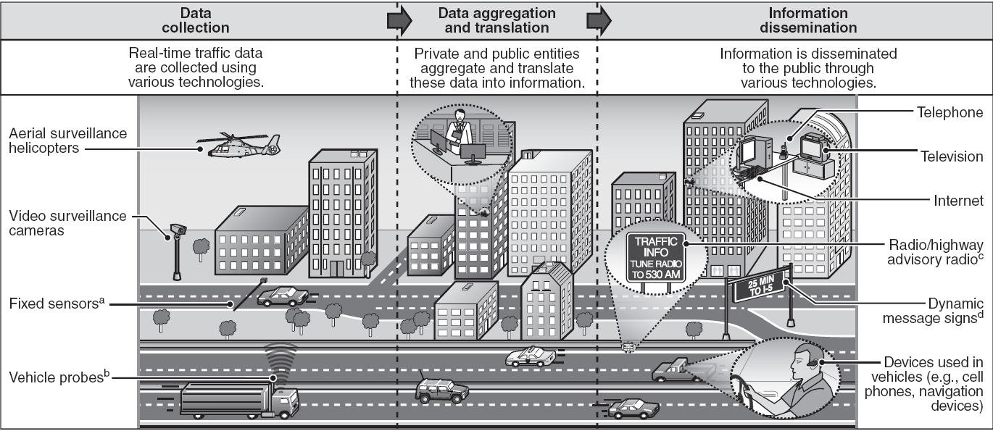
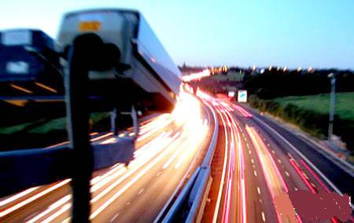
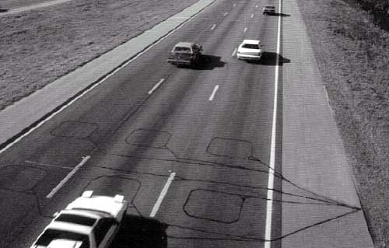
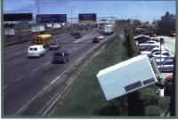
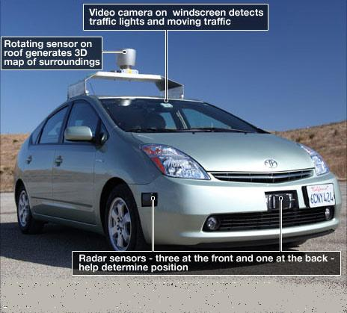
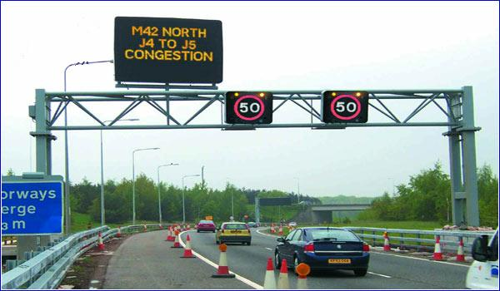
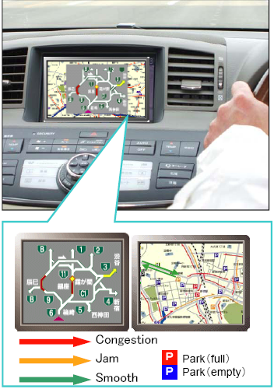
Enabling Technology
Sensing technology : infrastructure sensors (CCTV, inductive loop, infrared), vehicle sensors (radar, GPS, video camera)
Wireless communication : short range (DSRC), long range (WiMAX, GSM)
Traffic data integration and information extraction
Traffic information dissemination
Notes:
Intelligent transportation systems vary in technologies applied, from basic management systems such as car navigation; traffic signal control systems; container management systems; variable message signs; automatic number plate recognition or speed cameras to monitor applications, such as security CCTV systems; and to more advanced applications that integrate live data and feedback from a number of other sources, such as parking guidance and information systems; weather information; bridge deicing systems; and the like. Additionally, predictive techniques are being developed in order to allow advanced modeling and comparison with historical baseline data. Some of the constituent technologies typically implemented in ITS are described in the following sections.
[1] Wireless communications
Various forms of wireless communications technologies have been proposed for intelligent transportation systems.
Radio modem communication on UHF and VHF frequencies are widely used for short and long range communication within ITS.
Short-range communications (less than 500 yards) can be accomplished using IEEE 802.11 protocols, specifically WAVE or the Dedicated Short Range Communications standard being promoted by the Intelligent Transportation Society of America and the United States Department of Transportation. Theoretically, the range of these protocols can be extended using Mobile ad-hoc networks or Mesh networking.
Longer range communications have been proposed using infrastructure networks such as WiMAX (IEEE 802.16), Global System for Mobile Communications (GSM), or 3G. Long-range communications using these methods are well established, but, unlike the short-range protocols, these methods require extensive and very expensive infrastructure deployment. There is lack of consensus as to what business model should support this infrastructure.
[2] Computational technologies
Recent advances in vehicle electronics have led to a move toward fewer, more capable computer processors on a vehicle. A typical vehicle in the early 2000s would have between 20 and 100 individual networked microcontroller/Programmable logic controller modules with non-real-time operating systems. The current trend is toward fewer, more costly microprocessor modules with hardware memory management and Real-Time Operating Systems. The new embedded system platforms allow for more sophisticated software applications to be implemented, including model-based process control, artificial intelligence, and ubiquitous computing. Perhaps the most important of these for Intelligent Transportation Systems is artificial intelligence.
[3] Floating car data/floating cellular data
Virtually every car contains one or more mobile phones. These mobile phones routinely transmit their location information to the network – even when no voice connection is established. This allows them to be used as anonymous traffic probes. As the car moves, so does the signal of the mobile phone. By measuring and analyzing network data, using triangulation, pattern matching or cell-sector statistics – in an anonymous format – the data is converted into accurate traffic flow information. With more congestion, there are more cars, more phones, and thus, more probes. In metropolitan areas, the distance between antennas is shorter and, thus, accuracy increases. No infrastructure needs to be built along the road; only the mobile phone network is leveraged. In some metropolitan areas, RFID signals from ETC transponders are used. Floating car data technology provides great advantages over existing methods of traffic measurement:
(1) much less expensive than sensors or cameras
(2) more coverage: all locations and streets
(3) faster to set up (no work zones) and less maintenance
(4) works in all weather conditions, including heavy rain
(5) Travel time data on freeways and arterial roadways is also being collected using sensors based on Bluetooth technology[2]. Travel times and speed are calculated by comparing the time at which a specific device signal is recorded by pairs of sensors.
[4] Sensing technologies
Technological advances in telecommunications and information technology coupled with state-of-the-art microchip, RFID, and inexpensive intelligent beacon sensing technologies have enhanced the technical capabilities that will facilitate motorist safety benefits for Intelligent transportation systems globally. Sensing systems for ITS are vehicle and infrastructure based networked systems, e.g., Intelligent vehicle technologies. Infrastructure sensors are indestructible (such as in-road reflectors) devices that are installed or embedded on the road, or surrounding the road (buildings, posts, and signs for example) as required and may be manually disseminated during preventive road construction maintenance or by sensor injection machinery for rapid deployment of the embedded radio frequency powered (or RFID) in-ground road sensors. Vehicle-sensing systems include deployment of infrastructure-to-vehicle and vehicle-to-infrastructure electronic beacons for identification communications and may also employ the benefits of CCTV automatic number plate recognition technology at desired intervals in order to increase sustained monitoring of suspect vehicles operating in critical zones.
[5] Video vehicle detection
Traffic flow measurement and automatic incident detection using video cameras is another form of vehicle detection. Since video detection systems such as those used in automatic number plate recognition do not involve installing any components directly into the road surface or roadbed, this type of system is known as a "non-intrusive" method of traffic detection. Video from black-and-white or color cameras is fed into processors that analyze the changing characteristics of the video image as vehicles pass. The cameras are typically mounted on poles or structures above or adjacent to the roadway. Most video detection systems require some initial configuration to "teach" the processor the baseline background image. This usually involves inputting known measurements such as the distance between lane lines or the height of the camera above the roadway. A single video detection processor can detect traffic simultaneously from one to eight cameras, depending on the brand and model. The typical output from a video detection system is lane-by-lane vehicle speeds, counts, and lane occupancy readings. Some systems provide additional outputs including gap, headway, stopped-vehicle detection, and wrong-way vehicle alarms.

Slide 12
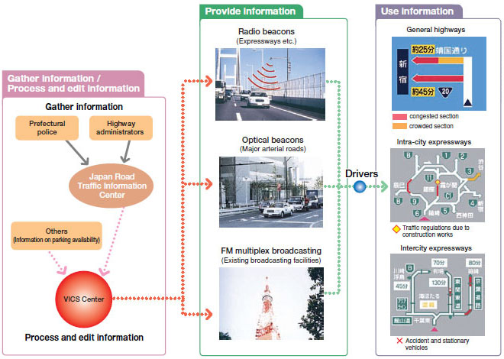
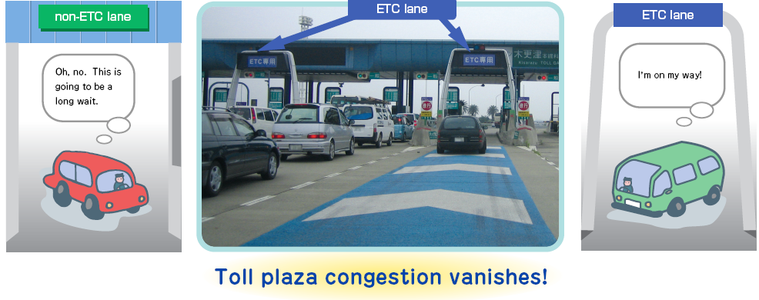
ITS in Japan :VICS
VICS (Vehicle Information and Communication System, 1996), provides easy to understand, real-time information for drivers
ETC: the electronic toll collection system

Slide 13
ITS in Japan :VICS

Slide 14
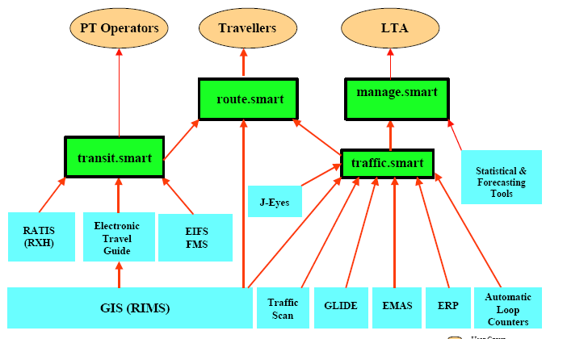
ITS in Singapore: i-Transport
Part 1: Integration of Traffic Information (Traffic.Smart)
Part 2: Integration of Public Transport Information (Transit.Smart)
Part 3: Multi-modal Route Advisory System (or Route.Smart)

Slide 15
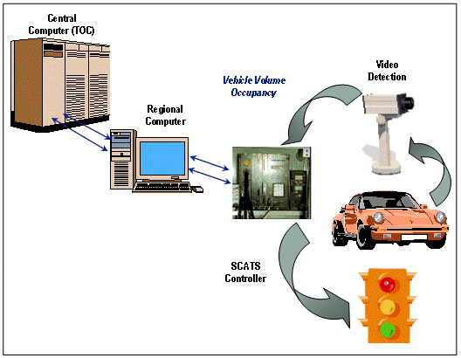
ITS in Australia: SCATS
SCATS (Sydney Coordinated Adaptive Traffic System)
Notes:
SCATS intersections are outfitted with video detection cameras. These cameras include computer software that enables them to count the number of cars stopped at intersection, the number of cars going through on green signals and vehicle speeds. This information is sent to a central computer, which compares current traffic flows to trends over the past few years and to traffic conditions at other intersections along the same street. The SCATS computer can then calculate the mix of green and red signal time that will minimize the total time for all drivers on the system.

Slide 16
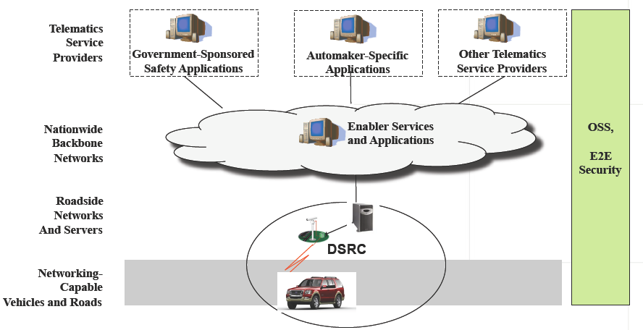
ITS in USA - VII
Vehicle infrastructure integration(VII) : a nationwide vehicle communications system is designed to improve transportation safety and quality (target deployment around 2011)
Notes:
SCATS intersections are outfitted with video detection cameras. These cameras include computer software that enables them to count the number of cars stopped at intersection, the number of cars going through on green signals and vehicle speeds. This information is sent to a central computer, which compares current traffic flows to trends over the past few years and to traffic conditions at other intersections along the same street. The SCATS computer can then calculate the mix of green and red signal time that will minimize the total time for all drivers on the system.

Slide 17
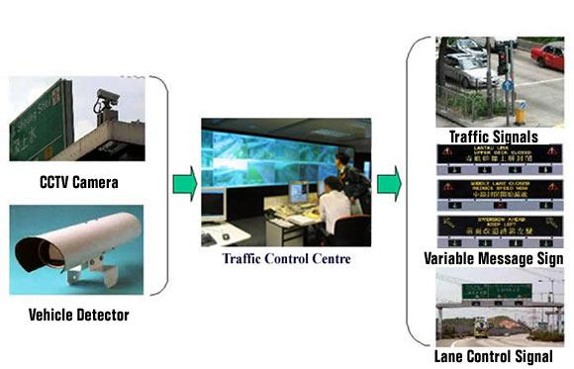
ITS in Hong Kong
TCSS (Traffic Control and Surveillance Systems)
Notes:
TCSS (Traffic Control and Surveillance System) controls the traffic flow through traffic signals, message signboards, and lane control signals.

Slide 18
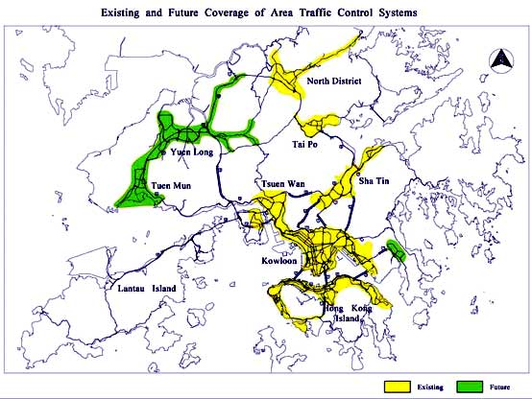
ITS in Hong Kong
Notes:
Traffic Control and Surveillance Systems (TCSS) are being installed at Island East Corridor and Tolo Fanling Highways, while five existing TCSSs are being upgraded.

Slide 19
Limitation of Existing ITS
High cost
Long cabling, expensive data acquisition system
Deployment can cause traffic to interrupt during installation
Low density
Only deployed in busiest roads
Centralized
Not scalable, not fault-tolerant
Delay can be large for emergency
Lack of flexibility to handle dynamic complex events
Notes:
ITSs depended on traditional monitoring sensors including inductive loops, video cameras, ultrasonic sensors, radar. However, these sensors suffered from major drawbacks that affected the sole purpose behind incorporating intelligence in transportation systems. In particular, these sensors are bulky, power-hungry, expensive to install,
maintain and repair, and connected through wires to central data processing locations. These characteristics subvert the scalability of ITSs and affect their major objectives, like traffic monitoring or collision avoidance.
Incorporating WSNs into ITSs can be enticing due to their special features that overcome the problems associated with traditional wired sensors. Wireless sensor nodes are small-sized, cheap, simple to install, densely deployed, power-efficient, and can be effectively self-configured to cope with sudden failures in
nodes. The fact that a single WSN is constituted by a large number of sensor nodes solved the scalability problem of traditional ITSs. Wireless sensors provide enhanced coverage of the transportation infrastructure and thus better decisions in the management of the traffic can be attained.

Slide 20
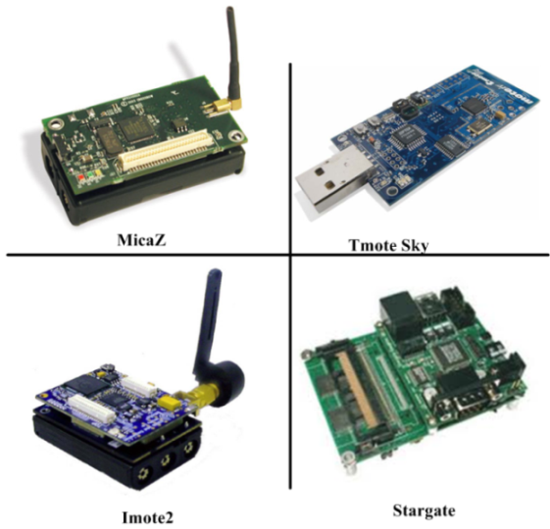
Wireless Sensor Networks
Smart sensor nodes
Low cost
Sensors + CPU +wireless transceivers
Wireless sensor networks
Self-organization
Self-maintenance
Sensor nodes deployment:
Road-side sensor units (RSU)
Vehicle/mobile sensor units (MU)

Slide 21
Why WSNs Can Help ITS?
Low cost
No cabling
Easy and flexible for deployment
High spatial density
In-network processing and distributed control
Scalable
Fault-tolerant
Allow real-time dynamic complex events processing

Slide 22
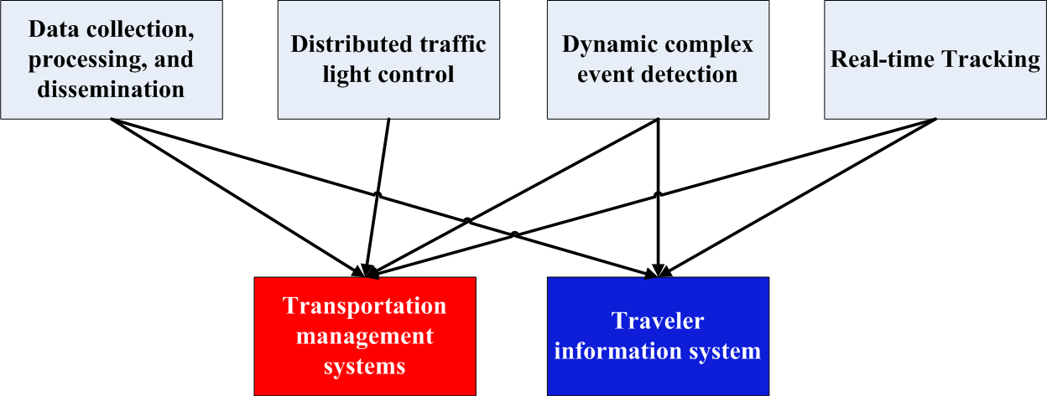
How WSNs Can Help ITS?
Data collection, processing, and dissemination
Distributed traffic light control
Dynamic complex event detection
Real-time tracking

Slide 23
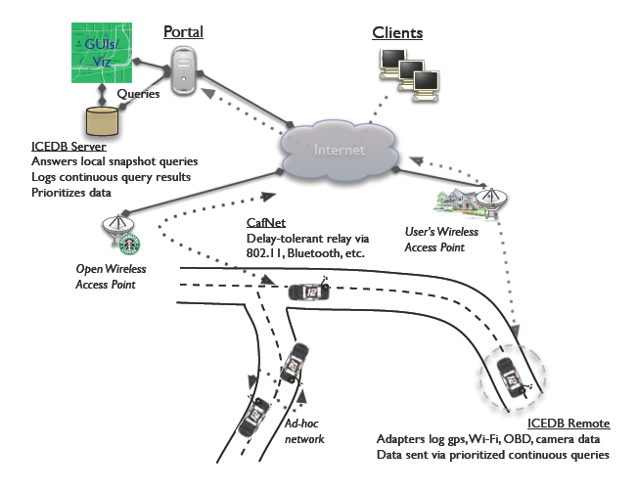
WSN for ITS: CarTel (MIT,2006)
A mobile sensor computing system designed to collect, process, deliver, and visualize data from mobile units
CarTel has been deployed on six cars, running on a small scale in Boston and Seattle for over a year
CarTel: A Distributed Mobile Sensor Computing System. Bret Hull, Vladimir Bychkovsky, Kevin Chen, Michel Goraczko, Allen Miu, Eugene Shih, Yang Zhang, Hari Balakrishnan, and Samuel Madden, in Proc. ACM SenSys, 2006
Notes:
CarTel is a distributed, mobile sensor network and telematics system. Applications built on top of this system can collect, process, deliver, analyze, and visualize data from sensors located on mobile units such as automobiles and smartphones. In our deployment, a small embedded computer interfaces with a variety of sensors, processes the collected data, and delivers it to an Internet server. Applications running on the server analyze this data and provide interesting services to users

Slide 24
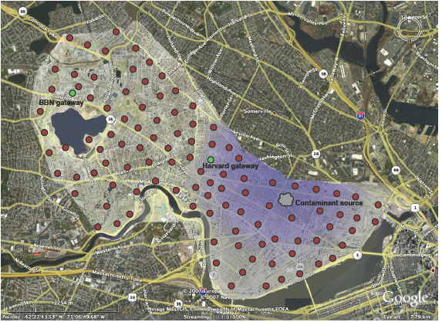
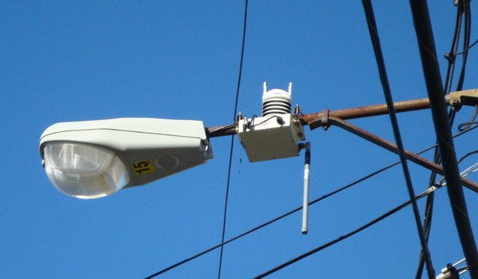
WSN for ITS: CitySense (Harvard , 2007)
Urban scale sensor network testbed
100 sensor nodes
Monitoring weather conditions and air pollutants
R. Murty, Citysense: A vision for an urbanscale wireless networking testbed. Technical Report TR-13-07, Harvard University, September 2007.
Notes:
Your browser does not support iframes.
CitySense is an urban scale sensor network testbed that is being developed by researchers at Harvard University and BBN Technologies. CitySense will consist of 100 wireless sensors deployed across a city, such as on light poles and private or public buildings; our current target is to deploy the network in Cambridge, MA. Each node will consist of an embedded PC, 802.11a/b/g interface, and various sensors for monitoring weather conditions and air pollutants. Most importantly, CitySense is intended to be an open testbed that researchers from all over the world can use to evaluate wireless networking and sensor network applications in a large-scale urban setting.

Slide 25
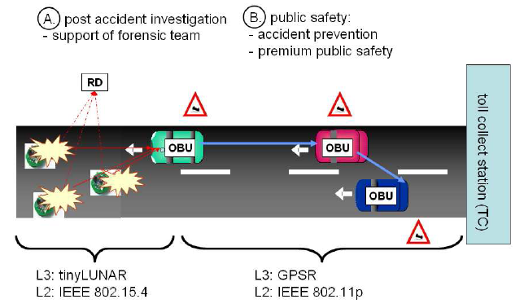
WSN Roadside Architecture (NEC Europe Ltd ,2008)
Accident prevention:
Roadside sensor nodes measure the road condition, and send to a passing vehicle.
The vehicle generates a warning message and distributes it to all vehicles in a certain area
Post-accident investigation
sensor nodes continuously measure the road condition and store this information for application users
Bohli, J., et al. A secure and resilient WSN roadside architecture for intelligent transport systems. WiSec’08
Notes:
To support accident prevention, roadside sensor nodes measure the road condition at several positions on the surface, aggregate the measured values and communicate their aggregated value to a passing vehicle. The vehicle generates a warning message and distributes it to all vehicles in a certain area, e.g. by using a specific form of georouting, namely geocast. One can even imagine chargeable premium services. Services like velocity assistance and recommendations or more generally infrastructure-based traffic control may be attractive for the driver. They increase the driver's comfort without causing emergency situations in the absence of such services. Technically, one could provide such services by piggybacking WSN roadside information of a WSN far ahead via a vehicle driving in the opposite direction and downloading it to a near-by WSN for the oncoming traffic.
To support post-accident investigation, sensor nodes continuously measure the road condition and store this information within the WSN itself. Storing the road condition over the long run may be of interest for a forensic team. In contrast to the accident prevention service, such a liability service will be limited to a well specified group of end-users, e.g. insurance companies or the road patrol. Information stored within the WSN will be helpful to judge a driver's driving style according to the road condition at the moment of an accident. We point out that the post accident investigation service does not require any VANET communication.
An IEEE 802.15.4 enabled reader device (RD) allowing authorized queries to the WSN roadside island is adequate.
Therefore, this service can be a stimulating activity ensuring the critical mass during the penetration phase of a full edged ITS architecture for vehicles.

Slide 26
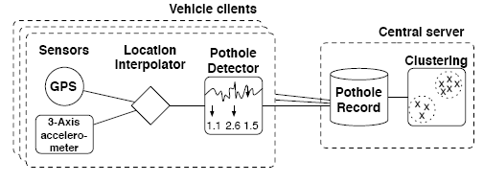
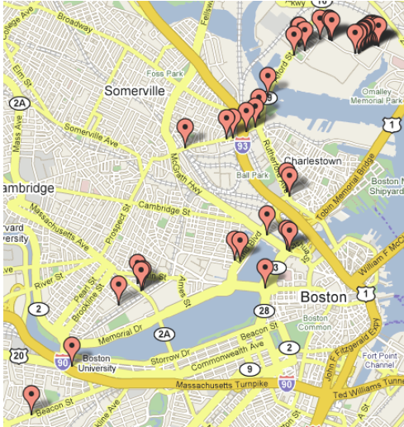
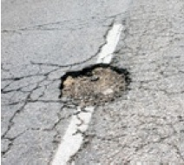
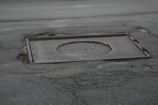
Pothole Patrol (MIT,2008)
Use cars to monitor the road surface condition:
Sensors are deployed on cars as mobile units
Mainly focus on how to detect potholes
Eriksson, J., et al. The pothole patrol: Using a mobile sensor network for road surface monitoring. 2008: ACM Mobisys
Notes:
This paper investigates an application of mobile sensing: detecting and reporting the surface conditions of roads. We describe a system and associated algorithms to monitor this important civil infrastructure using a collection of sensor-equipped vehicles. This system, which we call the Pothole Patrol (P2), uses the inherent mobility of the participating vehicles, opportunistically gathering data from vibration and GPS sensors, and processing the data to assess road surface conditions. We have deployed P2 on 7 taxis running in the Boston area. Using a simple machine-learning approach, we show that we are able to identify potholes and other severe road surface anomalies from accelerometer data. Via careful selection of training data and signal features, we have been able to build a detector that misidentifies good road segments as having potholes less than 0.2% of the time. We evaluate our system on data from thousands of kilometers of taxi drives, and show that it can successfully detect a number of real potholes in and around the Boston area. After clustering to further reduce spurious detections, manual inspection of reported potholes shows that over 90% contain road anomalies in need of repair.

Slide 27
Challenges of Using WSNs for ITS
Distributed detection & report of composite events (e.g. for detecting traffic jam)
Reliable delivery of real time data (e.g. collision avoidance)
WSN-based traffic light control
Middleware support for event processing
Energy efficient coverage for object tracking

Slide 28
Challenge 1: Composite Event Detection
Users have no prior knowledge on the location and the time of the events
Centralized event detection mechanisms may not be suitable for WSNs due to energy constraints
Issues in distributed composite event detection:
Who will be the decision makers (event fusion nodes) for event detection
How to select these decision makers

Slide 29
The Distributed Composite Event Detection Problem
Given:
A sensor network
Event types with relations (composite events can consist of multiple lower level events)
Assumptions:
Event definition (type and relations are known to all nodes)
Each primitive event is detected by a single node
Events can happen anywhere at any time
Composite events have to be detected by a group of nodes
Objective:
Once the events occur, find an efficient algorithm which will involve minimum number of nodes for detecting the events
The energy consumption is minimized

Slide 30
Approaches
When events occur, participating nodes flood a message and identify partner participating nodes to come out with a coordinated fusion structure (fully distributed but inefficient)
When events occur, participating nodes report to the sink about the event types they detected. Then sink comes out with an optimal fusion structure.
Some nodes are pre-selected as fusion points in the network. When events occur, participating nodes randomly but smartly select a subset of those fusion points to detect events.

Slide 31
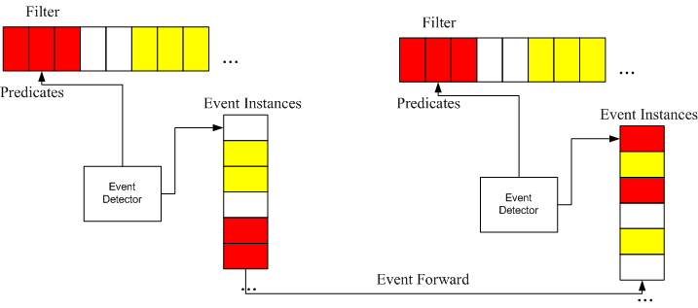
Event Detection Framework
Steps:
When nodes first detect events, they will randomly forward the events to certain nearby fusion points.
Upon the detection of composite events, the fusion points will send feedback to the event sources so that nodes can compare which fusion point to select for each event type.
Fusion point selection:
Optimization problem: more fusion points will result in less detection cost but more maintenance cost.

Slide 32
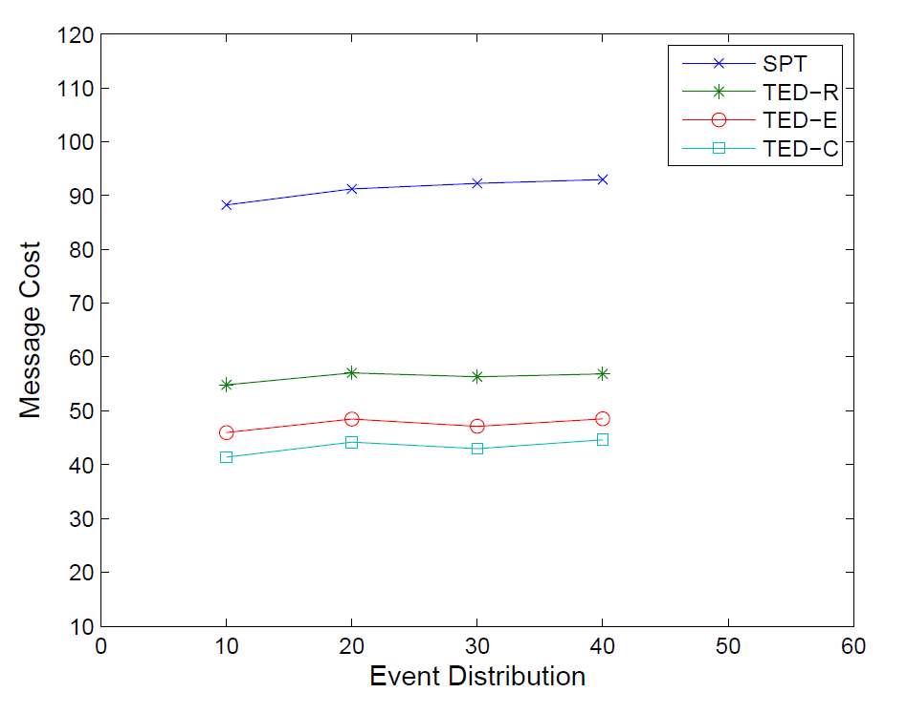
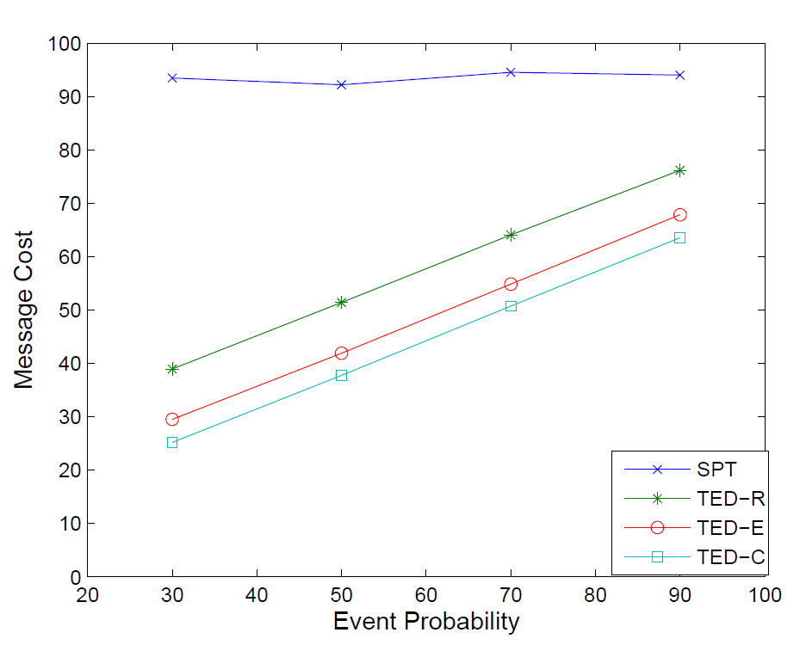
Performance Evaluation
Compared with shortest path approach where the event relations are not considered for detection

Slide 33
Challenge 2: Reliable Message Delivery
For certain ITS applications such as collision avoidance, reliable message delivery is required.
Wireless links may be unreliable
Due to high mobility in ITS, the messages may have unknown number of receivers
If a message is sent without reply, it is hard to distinguish if the message is lost or there is simply no receiver.

Slide 34
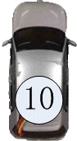
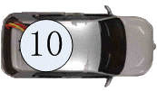
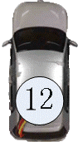
Solution to Reliable Message Delivery
Use RSU as relay nodes to improve message reliability
Registration phase: vehicles will register when they pass intersections where accidents are more likely to occur
Message delivery phase: vehicles communicate with each other through RSU.

Slide 35
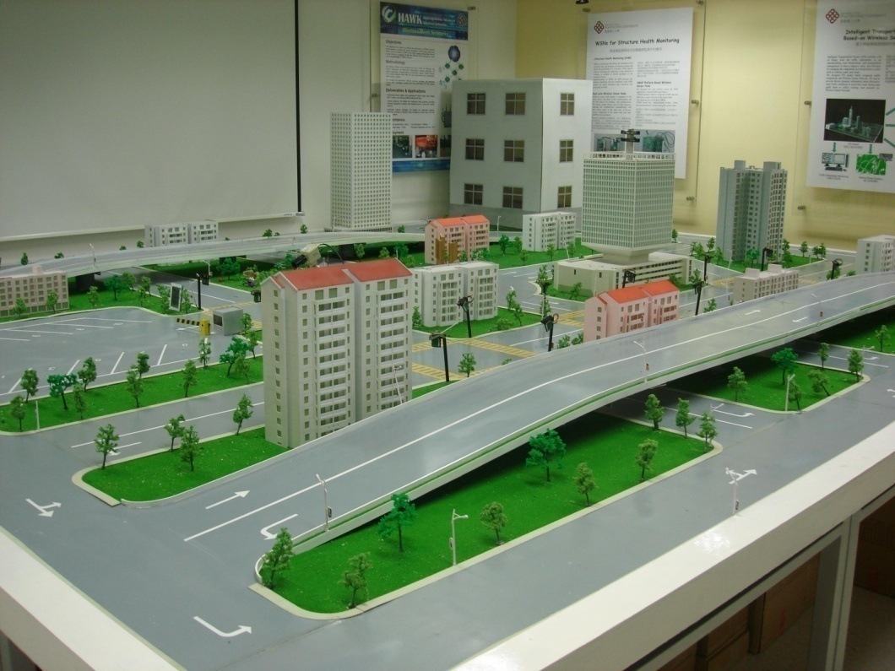
iTranSNet Testbed at PolyU

Slide 36

Collision Avoidance Demo

Slide 37
Challenge 3: Collaborative Traffic Light Control using WSNs
Traditional traffic light control
Independent control of the traffic light for each intersection
Centralized control of multiple intersections
We wish to use WSNs to control the traffic lights of multiple intersections in a distributed way
Information of a intersection is exchanged with those of neighboring intersections
Traffic lights from multiple intersections collaboratively to maximize the overall througput

Slide 38
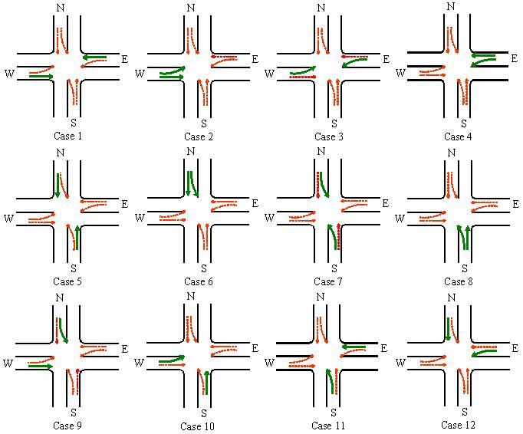
Collaborative Traffic Light Control of Multiple Intersections
Divide the traffic light sequences into twelve different cases.
Select one case to assign green light using the real-time traffic data detected.
Determine the light length based on local traffic volume and remaining durations of green lights of neighbor intersections.

Slide 39
Performance Evaluation
Average waiting time comparisons between the four approaches.
Average number of stops comparisons between the four approaches.
Throughput-to-volume comparisons between the four approaches.
Average waiting time comparisons between the three approaches.
Notes:
39

Slide 40
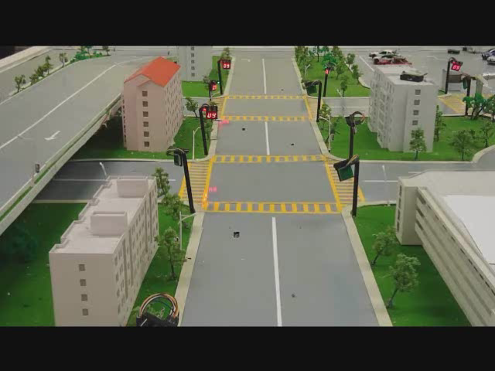
Adaptive Traffic Light Control Demo

Slide 41
Challenge 4: Middleware for ITS
Programming the sensor network is non-trivial
Certain functions such as event detection are shared by different ITS applications
Implementing these functions from scratch in different ITS applications may be difficult and not efficient.
To avoid reinventing the wheel, we need to have a middleware layer capable of supporting the common functions used by ITS

Slide 42
Middleware Approaches
Programming abstraction:
Pub/sub-based: define events and make subscriptions to get the events from WSN
Query-based: treat the WSN as a database and use SQL to query the data
Agent-based: inject mobile codes into WSN
Why pub/sub is more suitable:
Many ITS applications are event-based
Other programming abstraction have limitation to express the temporal and spatial relations between events

Slide 43
Pub/Sub Middleware for WSN (PSWare)
Design Issues:
Provide event definition language (EDL)
Implement event detection mechanisms
Implement event delivery mechanisms
System components:
EDL compiler/interpreter
Runtime environment on the sensor nodes for event processing

Slide 44
PSWare System Architecture

Slide 45
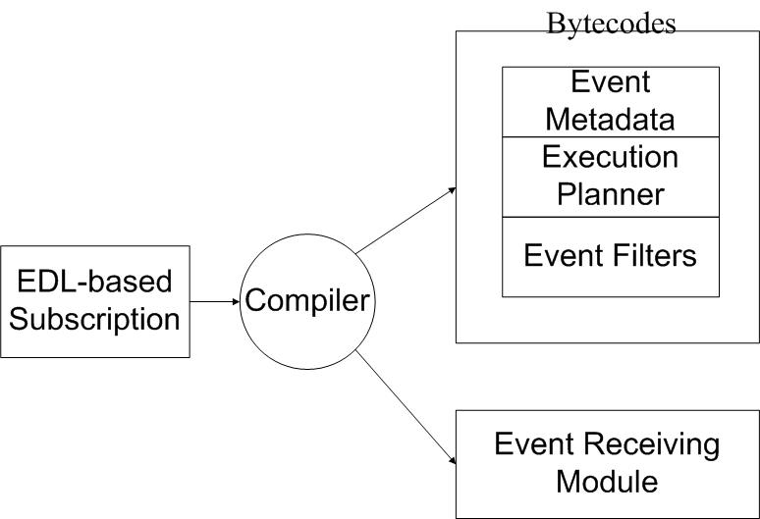
EDL and Its Compiler
Event CompTemp {
} on {
AvgTemp e1 and
AvgTemp e2
} where {
e2.time-e1.time=600
}

Slide 46
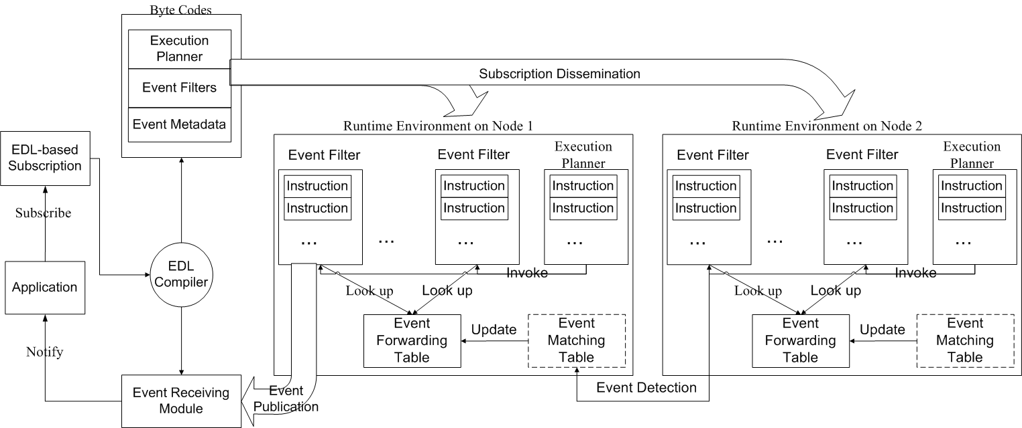
Runtime Environment on Sensor Nodes

Slide 47
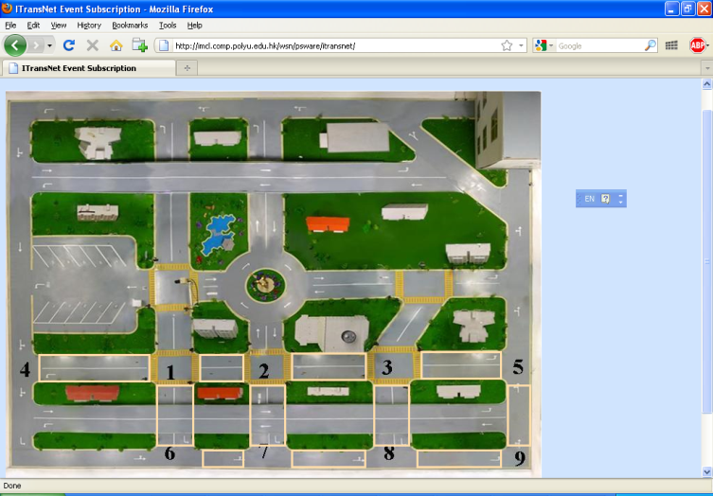
PSWare-based Traffic Jam Subscription
Pre-defined event templates for iTranSNet
Users can customize the events by changing parameters
Events may be subscribed / published through the web.

Slide 48

Pub/Sub Middleware Demo

Slide 49
Challenge 5: Energy-efficient Tracking using WSNs
Tracking using wireless sensor nodes is difficult because
Each sensor node has a limited coverage area, tracking a moving object requires collaboration of multiple sensor nodes
The obtained information needs to be delivered through a route to a base station
Wireless sensor nodes have limited power supply
Objective
Design an energy-efficient tracking protocols using wireless sensor nodes
Notes:
49

Slide 50
Our Approach
Basic idea: establish a routing path from a sensor node which detected object such that
nodes in the routing path can cover as large area as possible
the delay of delivery the message from the sensor node to the sink is smaller than a specified value
Approach: use Monte-Carlo integration to calculate the sensing area and adopt the modified label setting (LS) algorithm to establish the routing in a distributed way.
Notes:
50

Slide 51


Performance
The paths in the left and right figures are obtained using proposed algorithm and the k-hop path algorithm, respectively.
The total sensing area of the nodes in the routing path using our method is 1.5 times larger
Notes:
51

Slide 52
Conclusion
Heterogeneous network
Different wireless sensor nodes with different types of sensors
More efficient event detection
Consider energy balance
Reliable with short latency multi-hop communication techniques
Routing and data delivery by making use of vehicles and RSU
Different types of ACK
WSN for autonomous vehicles

Slide 53


THANK YOU

